Slide 1

BEYOND ALICE'S WILDEST DREAMS: THE CHALLENGES OF DE SITTER VACUA IN STRING THEORY

Slide 2
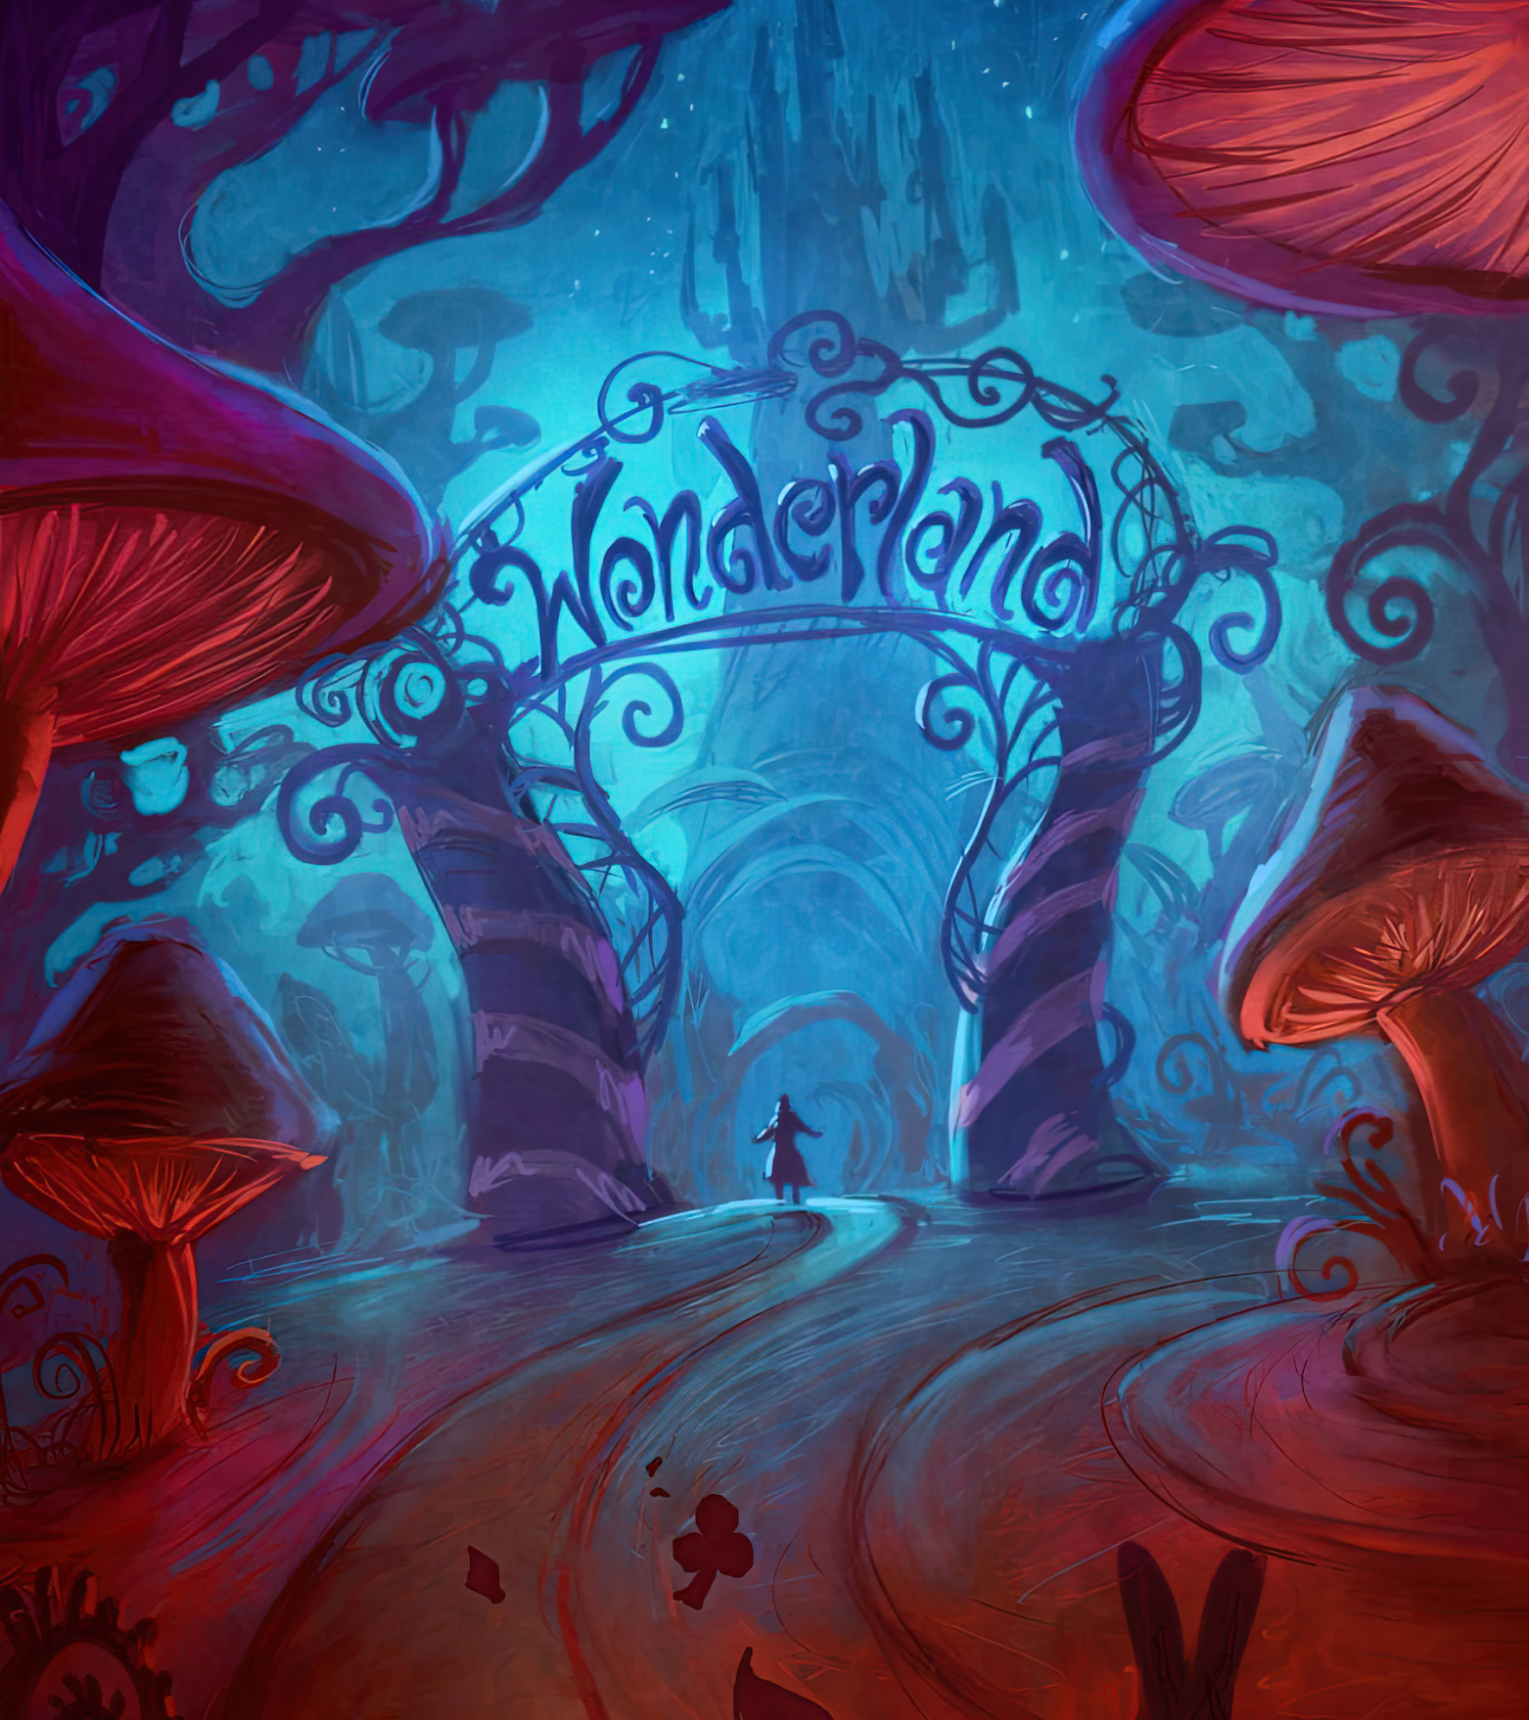
Outline
Why use string theory?
Recovering our universe de Sitter: compactification
Fields in expanding spacetime
Resolution: coherent states
The uncensored landscape

Slide 3

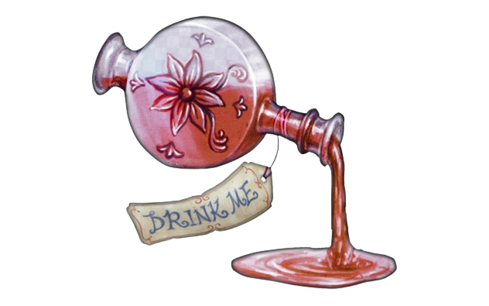
Why use string theory?
Physics is the study of interactions and phenomena at different length scales. At shorter length scales we have the quantum sector (QFT), while at higher scales we have the classical sector (GR):
It is often the case that low length scale theories (high energy scale) do not directly affect the features high length scale theories (or vice versa).
This means we cannot use one theory defined at one energy scale to describe phenomena at another; there is no scale consistency. The inconsistency of QFT and GR with coincident scales is known as the problem of quantum gravity.
String theory is what is known as an ultraviolet complete theory and so if it is the correct theory, it gives us a consistent quantum theory of gravity valid at all energy scales.

Slide 4
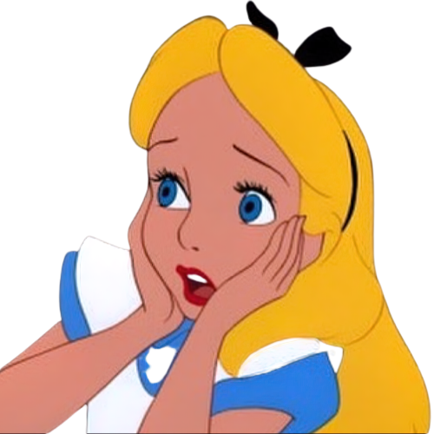
Why use string theory?
" Energy scale self-consistency is great, but I have heard the string theory is wrong, so why bother?" you might ask yourself.
String theory is a self-consistent theory which is a candidate to describe physics at all scales: a unified theory. Although it has this property, currently the formulation does not reproduce phenomena seen in nature.
Remark: Many of our theories which do reproduce properties of nature such as QFT or GR reveal many flaws under closer inspection:
The spacetime surfaces in general relativity (3 spatial directions and 1 temporal one) have singularities defined on them which come from energy sources. These singularities are inevitable due to theorems developed by Penrose & Hawking
The perturbative Feynman interaction diagrams in QFT scale as n! meaning perturbation theory fails for higher order diagrams.
String theory, although currently not agreeing with nature, does not run into any of the issues of the theories mentioned above and thus, it shall be used!

Slide 5

de Sitter space and compactification
We live in a 3+1D universe which has nearly-vanishing positive curvature and expands. A candidate with these properties is de Sitter space dS₄, the Lorentzian analogue to the 4D 3-sphere in Riemann geometry. de Sitter space is what is known as a homogeneous/vacuum solution to the Einstein field equations (essentially a PDE where the solutions are different spacetimes).
We consider type II string theory which is consistent in 9+1D. We however live in a 3+1D universe, so how can we recover our universe from a higher dimensional theory? This is done by decomposing the higher dimensional space into a 3+1D piece (the external space we live in), and a 6D piece (the internal space). We then take the 6D piece to vanish in size, which is known as compactification.
"What am I listening to? I thought it was teatime." I hear you say. Let's look at some examples!

Slide 6
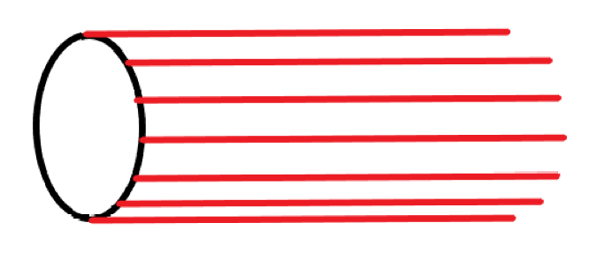
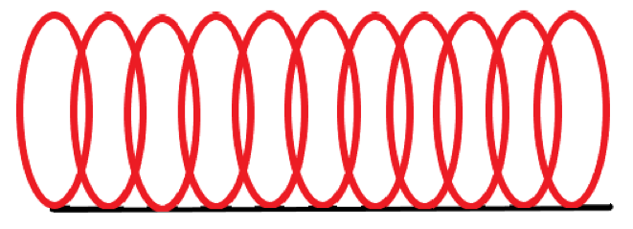
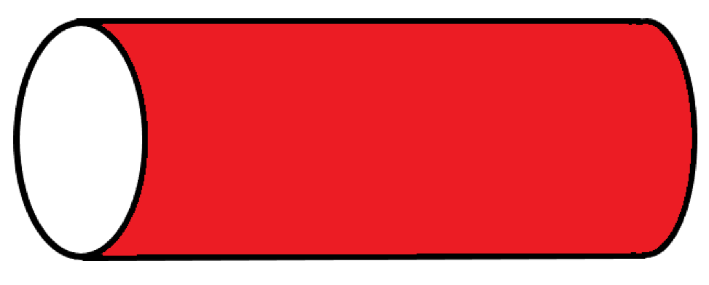
Say we have some space A which we would like to decompose into the spaces B & C, what is the simplest way to do this? Product spaces! A = B x C, but what does this mean?
Recall that there are two ways to interpret this: at every point in B, we have a copy of C, or at every point in C we have a copy of B.
This is less vague if we consider the space: M = S¹ x I. Here S¹ is the unit circle and I some finite subinterval of the real line R. Let's look at the two interpretations:
Both lead to a cylinder!

Slide 7
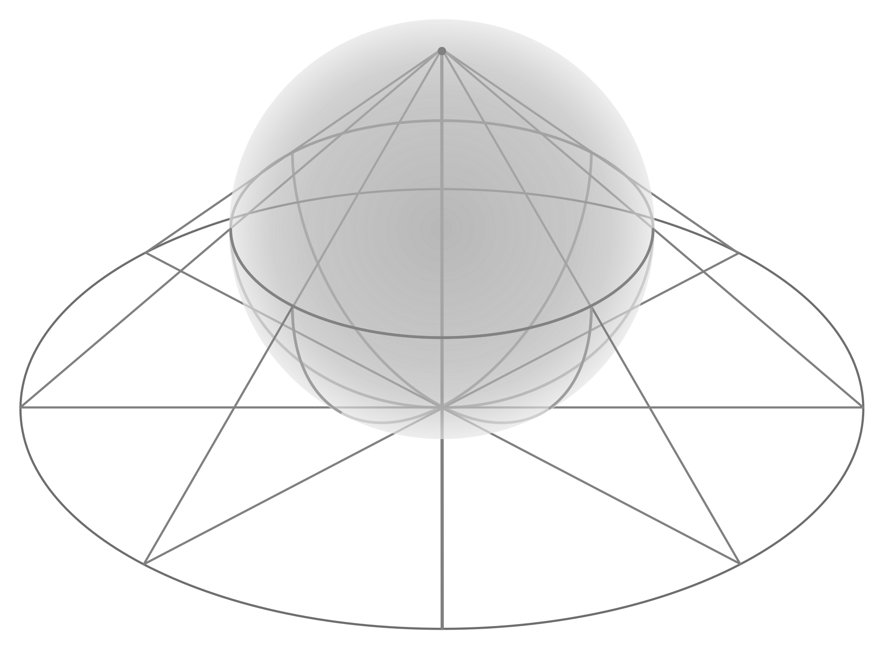
So, we can write our 9+1D spacetime as: M₁₀ = dS₄ x M₆, where dS₄ is our 3+1D de Sitter space universe, and M6 an internal space we take to shrink via compactification. What does it mean to compactify?
To understand this, we use an analogy to something you've likely heard called: stereographic projection.
By using a reference point at ∞, we can project/map different points of the sphere onto the plane (think of shining a flashlight at the top of a glass sphere with a grid pattern on it, which projects a flat grid patten onto the plane).
Compactification can be thought of the inverse of the above, where we take a non-compact space to be compact. In this sense we can construct a (Riemann) sphere from the complex plane by adding in a point from infinity.
∞

Slide 8
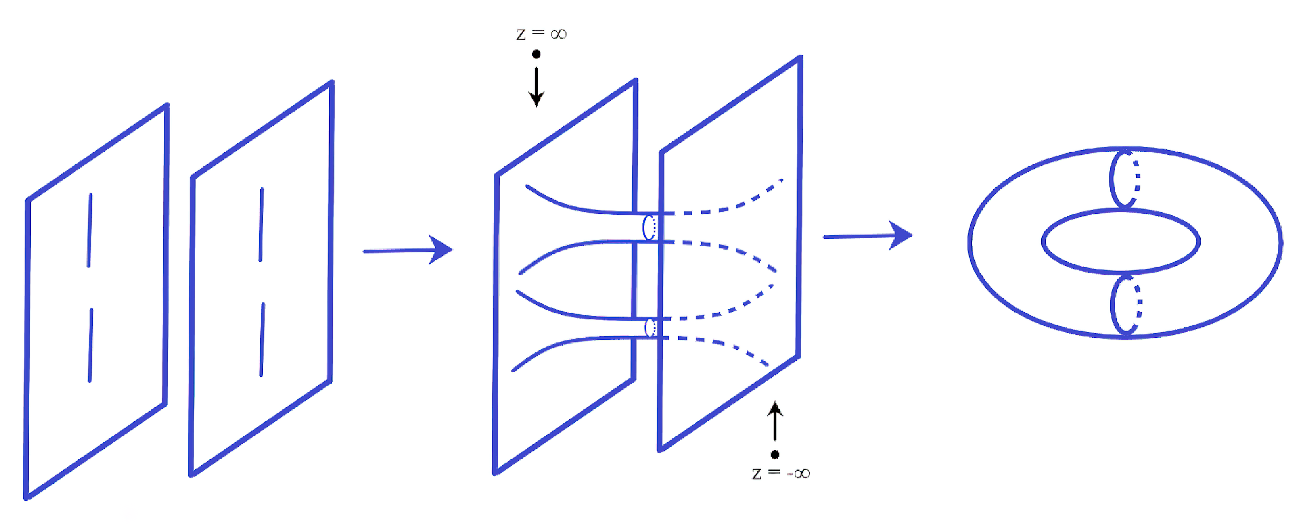
For the example of the cylinder, if we compactify it along the direction which parametrizes the unit circle, we recover the line.
Another example of compactification is the construction of a torus from two cut planes:
While the definition in math purely takes a non-compact space to a compact one, the definition in physics extends this by taking the compact space to shrink to vanishing size. Thus, we can recover our 3+1D universe my compactifying the 6D internal space (extra dimensions)!

Slide 9

Fields in expanding geometries
Now that we have a prescription on how to deal with these higher dimensional spaces, here lies the interest of the thesis:
The expansion of our universe is described by the positive cosmological constant: Λ > 0, which has a direct relationship to the vacuum/dark energy of the universe. For spaces with Λ > 0 (such as de Sitter space) we run into conflicts that the geometries with a negative cosmological constant don't. For brevity, one such conflict is:
Singularities on the spacetime surface (caused by energy sources) must be well behaved. This means that as we approach the singularity the first component of the spacetime metric (matrix that allows you to measure distances) g₀₀ must not diverge and must be bounded from above. It is found that for warped geometries that this is true only when our universe vanishes, and for non-warped geometries, the stress tensor components of the internal and external spaces contribute to the wrong sign of the cosmological constant.

Slide 10
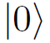
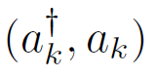
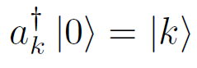
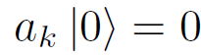
Thus, the goal of the thesis is to construct a framework where we can have non-singular compactifications to de Sitter space, from type II string theory. This will be done via quantum corrections to the metric.
Now, defining fields (which when excited give rise to particles) on an expanding and curved spacetimes are problematic. To see this, recall the QHO from your courses on quantum mechanics:
Here the eigenstate with the lowest energy is the ground/vacuum state . . Using the creation and annihilation operators XXX, we can either excite or kill as:
If the momenta k develop time dependence, then the operators will behave differently throughout time. This means we cannot have a consistent notion of a vacuum, or particle excited states.

Slide 11
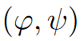
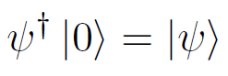
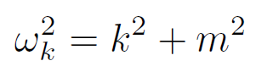
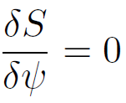
In our case we instead have fields XX which can excite the vacuum to give a particle state XXXX. . When quantized, the Fourier expansion coefficients are exactly the QHO operators, with frequencies given by:
We can recover the dynamics of these fields by taking functional derivatives of their action:
In the case of QFT, we have scalar fields which represent spin-0 bosons, and spinor fields X which represent fermions. When we put these fields on an accelerating background, we get the following results:
The scalar fields develop time-dependent mass which means we lose the notion of defining a vacuum (and particles), much like how we saw with the QHO
The spinor fields mass don't change but their EOM gains an extra piece which causes the Fourier expansion to have time-dependent frequencies. Thus, it runs into the same issue as the scalar field.

Slide 12
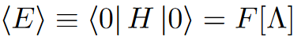

This means we cannot define the notion of a vacua (and thereafter particles) on an expanding geometry. This is problematic as we use vacua to compute the zero-point energy as:
From this we cannot extract nor its sign, meaning we have no well-defined description of an expanding spacetime this way. This makes use consider another framework:
We instead consider excited states to replace these ill-defined vacua over a static background. These excited states expand and share the isometries of de Sitter space, so this framework is of interest to model our universe with de Sitter space.

Slide 13
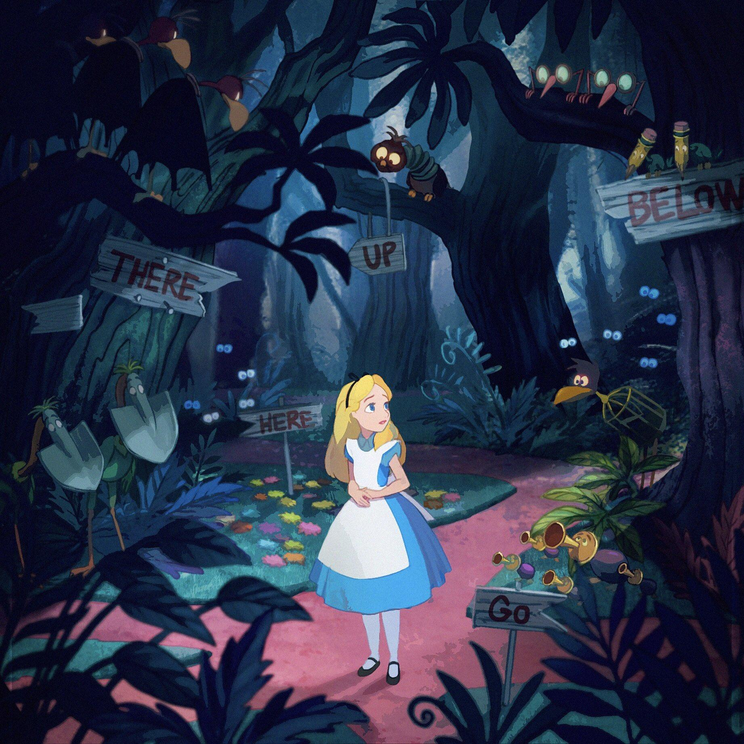
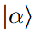
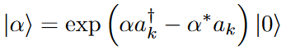
Coherent states
The states we consider are coherent states which are useful as they preserve the degree to which they exhibit wave-like behavior, such as interference and diffraction. They also they reproduce classical states closely as they have minimal uncertainty which is needed to reproduce classical results.
Furthermore, they preserve the isometries of de Sitter space and expand, thus can be used to model our de Sitter universe.
We can define the excited coherent states as the following:

Slide 14
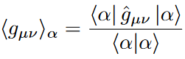
Now that we have a description of coherent states, we move onto computing quantum corrections to the metric that contribute towards the cosmological constant.
The normalized correction to the metric has the normalized form:
The terms on the right are in fact path integrals which sum over all possible evolutions of the fields in your theory. It turns out that because of the shift-structure of the coherent state (it is a shift of the vacuum to an excited state), we can compute these path integrals with nodal diagrams which are a class of general Feynman diagrams.
With the use of nodal diagrams, it is found that part of the quantum correction is exactly the integral form of the cosmological constant. Since the functional is positive definite, it produces the right sign of the cosmological constant, and so can model our universe with de Sitter space, coming from compactifications of type II string theory!

Slide 15
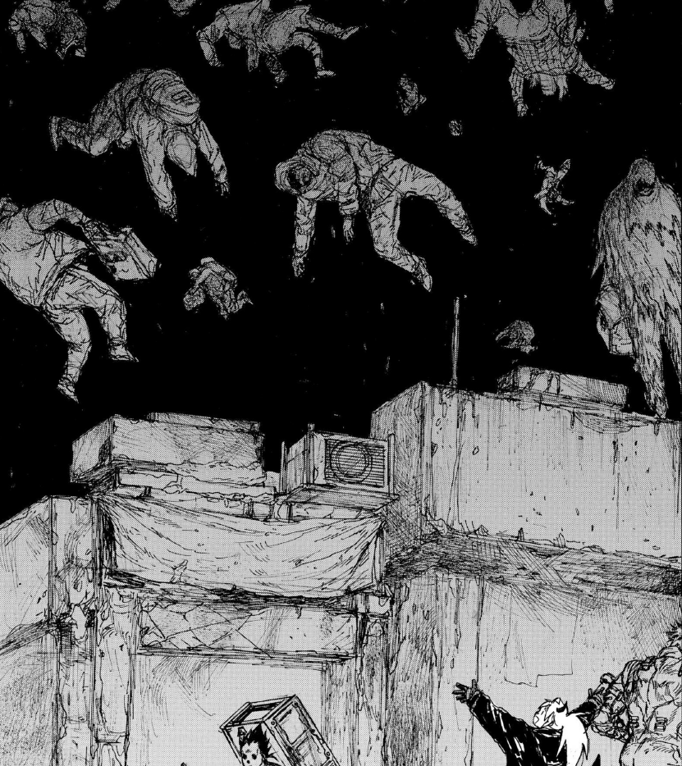
The uncensored landscape
What Alice couldn't see

Slide 16

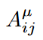
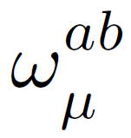
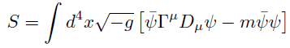
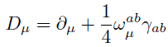
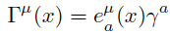
To define scalar & spinor fields we require vector and spinor bundles over our spacetime, which can be thought as generalized product spaces.
Each of these come with a connection which are objects that allow you to describe the evolution of the fields at different points of the curved manifold:
Focusing only on the spinors, this allows us to define the action of the field over the expanding curved space as:

Slide 17
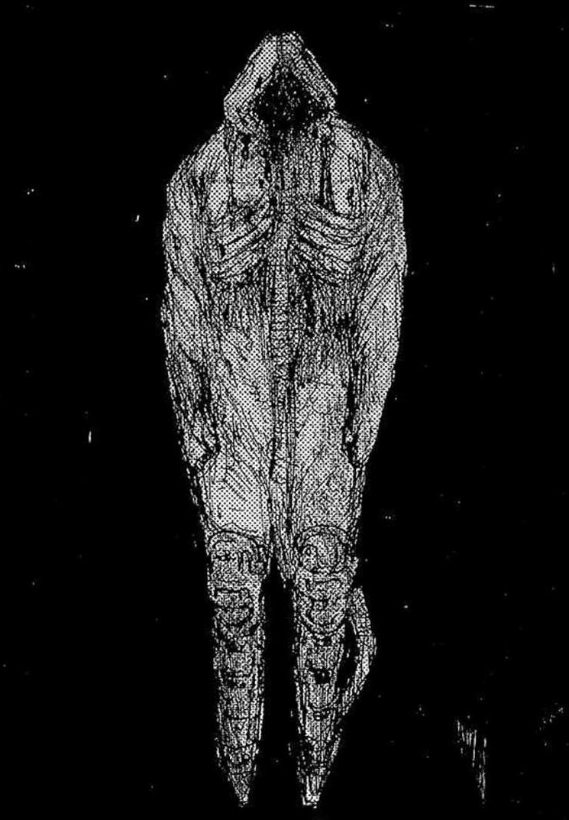
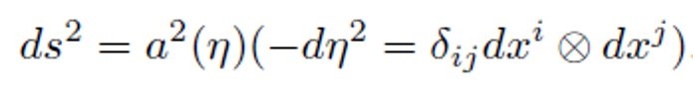
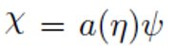
To look at the field dynamics on expanding geometries, we consider a FRW universe which is conformally related to Minkowski space:
Introducing an auxiliary spinor field XX which gives us a description for the fermion on an expanding space and after derivatives and spacetime splitting leads to the action:

Slide 18
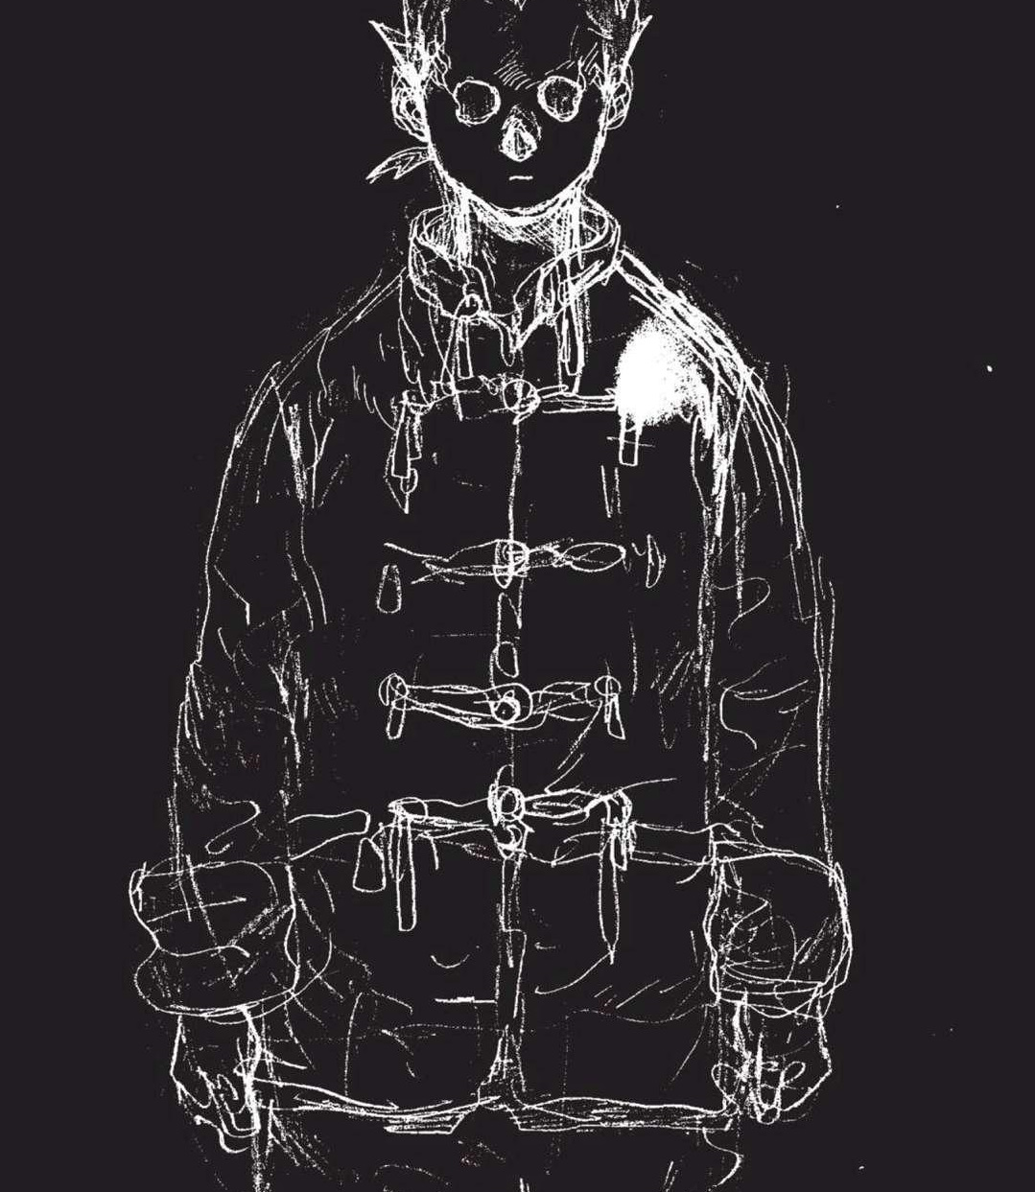
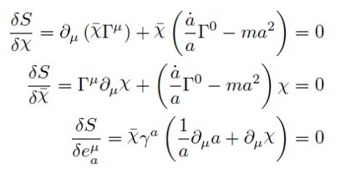
Taking functional derivatives of the action and setting it equal to zero gives us the equations of motion:​
​
​
​
The extra terms in the EOM lead to the spinor fields to have time-dependent frequencies in their Fourier expansion, and thus we cannot define a vacuum which they annihilate.​

Slide 19
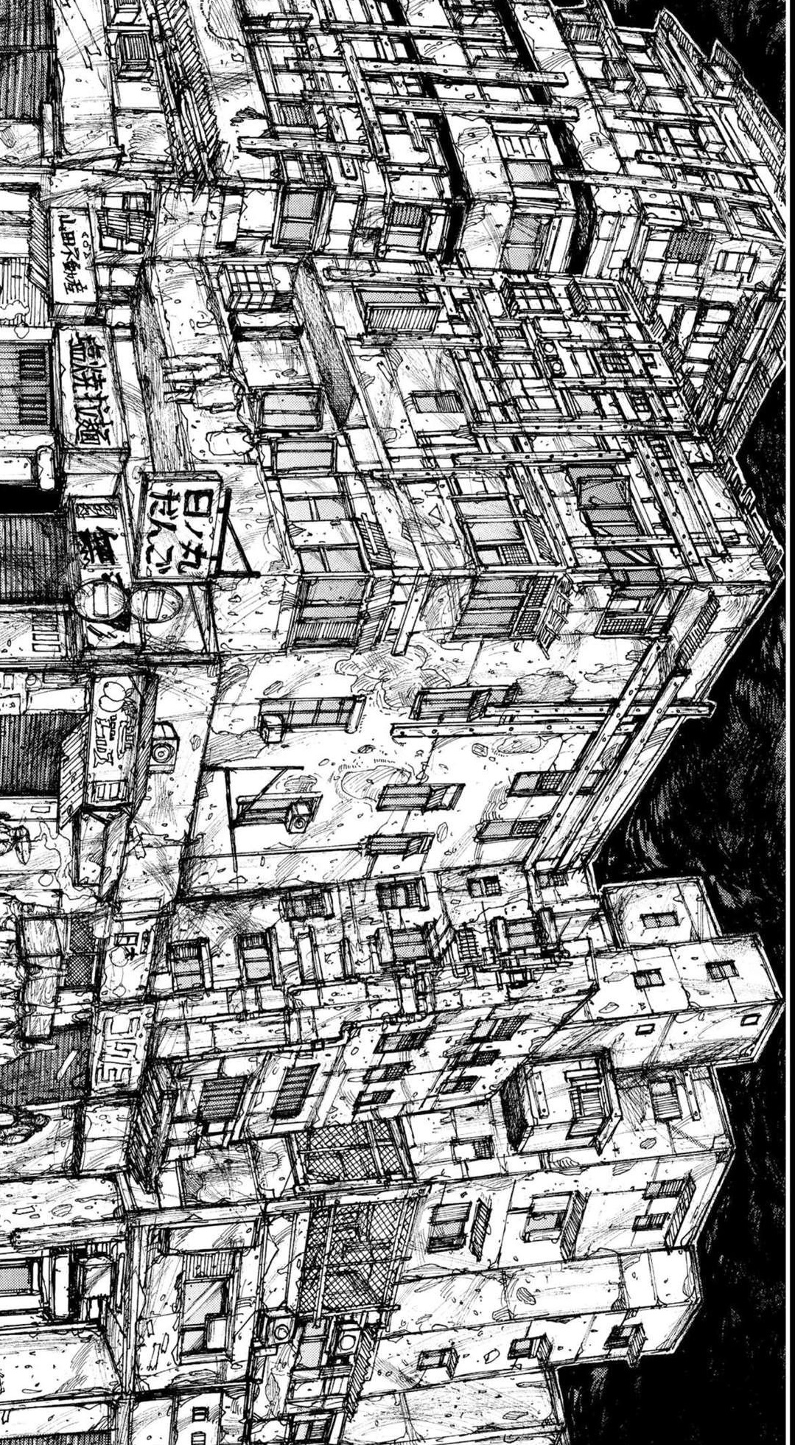
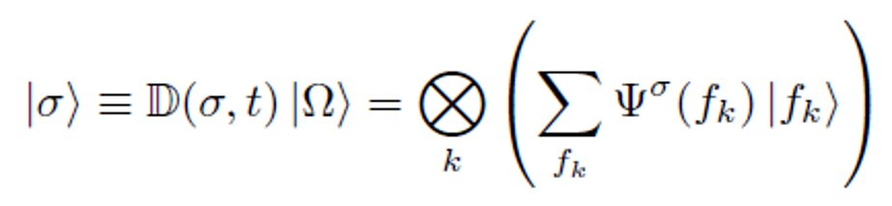
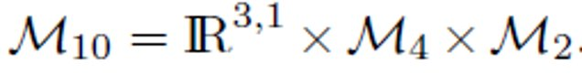
To avoid these issues, we look at general coherent states over a flat background, known as Glauber-Sudarshan states, which can be expressed as:
We consider these states defined over the following warped geometry:

Slide 20
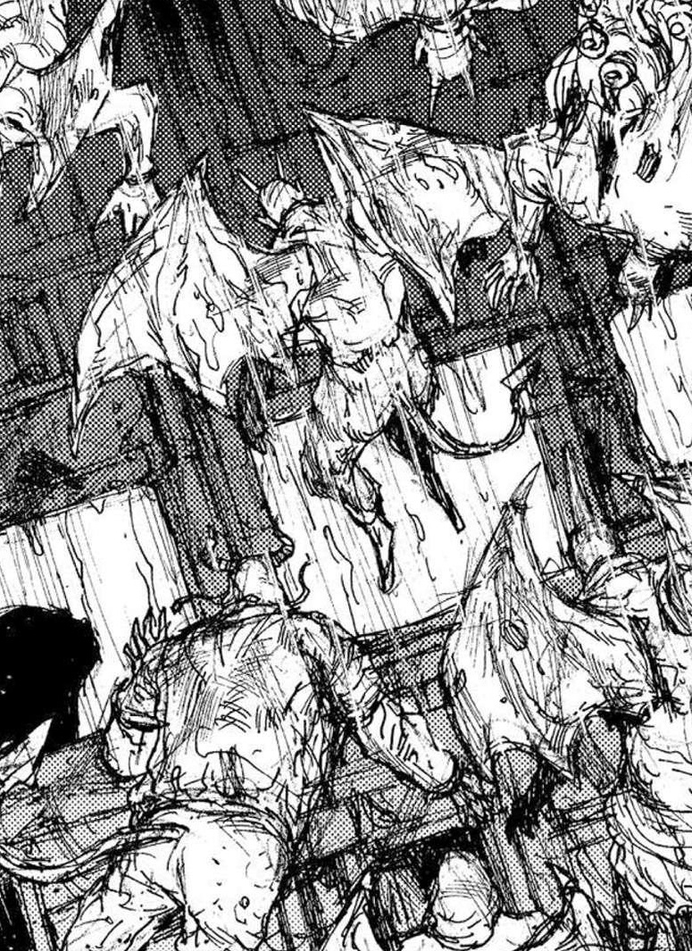
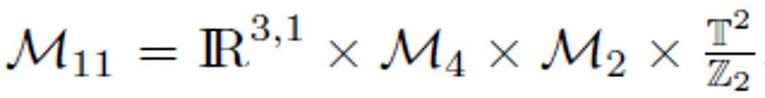
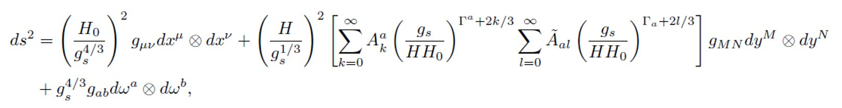
Now, when computing the quantum corrections, we run into path integrals that have the action of the theory within its argument.
As it currently stands then type II string theory does not have a well-defined action, so we will lift our theory (and compactify later) to an 11D string theory, known as M-theory, which does have a well-defined action.
The metric in this case is given by:

Slide 21
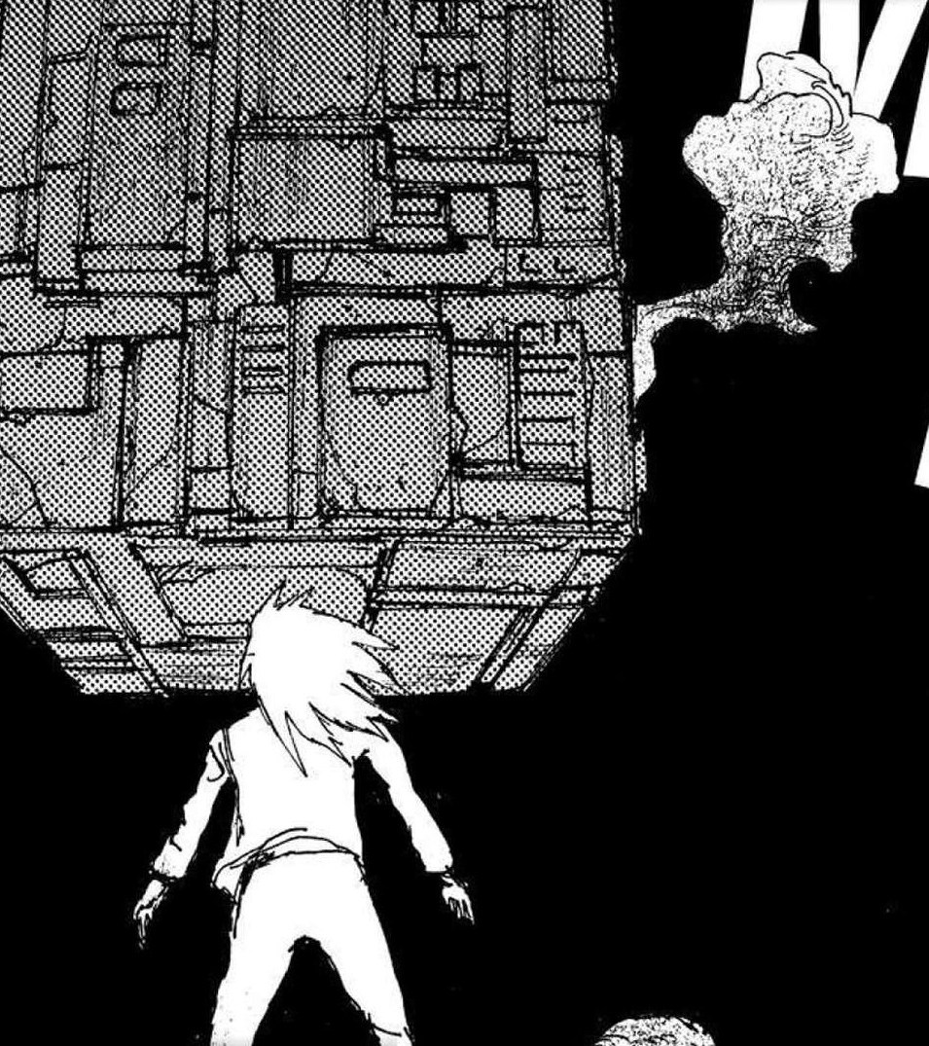
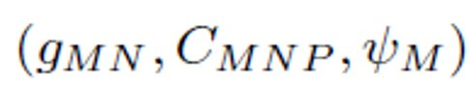
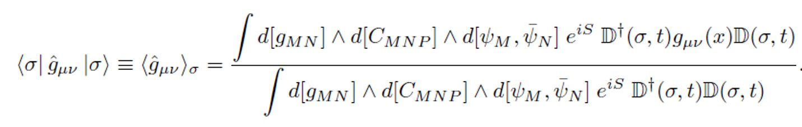
The multiplet or grouping of fields in M-theory is given by:
With these fields we can compute the quantum correction to the metric as the path integrals of the fields over the 11D space:

Slide 22

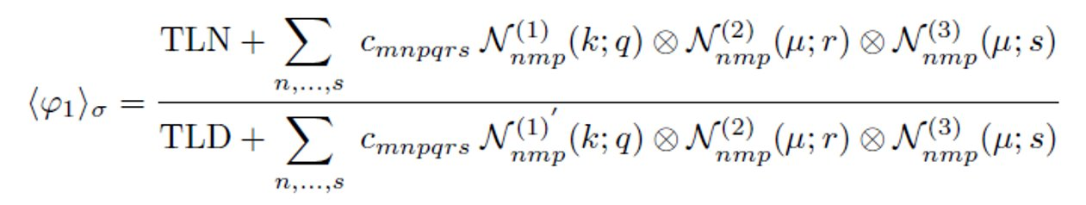
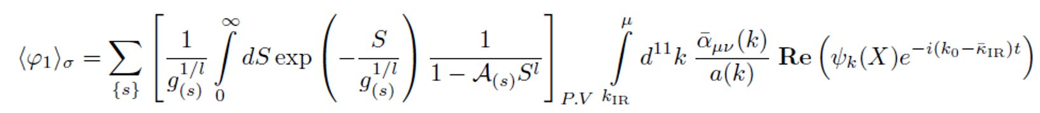
It turns out, because of the shift-structure of the Glauber-Sudarshan states, these path integrals fall under a general class of Feynman integrals, known as nodal diagrams, and the quantity can be expressed as:
Going through with this computation gives the quantum correction to the metric as:

Slide 23
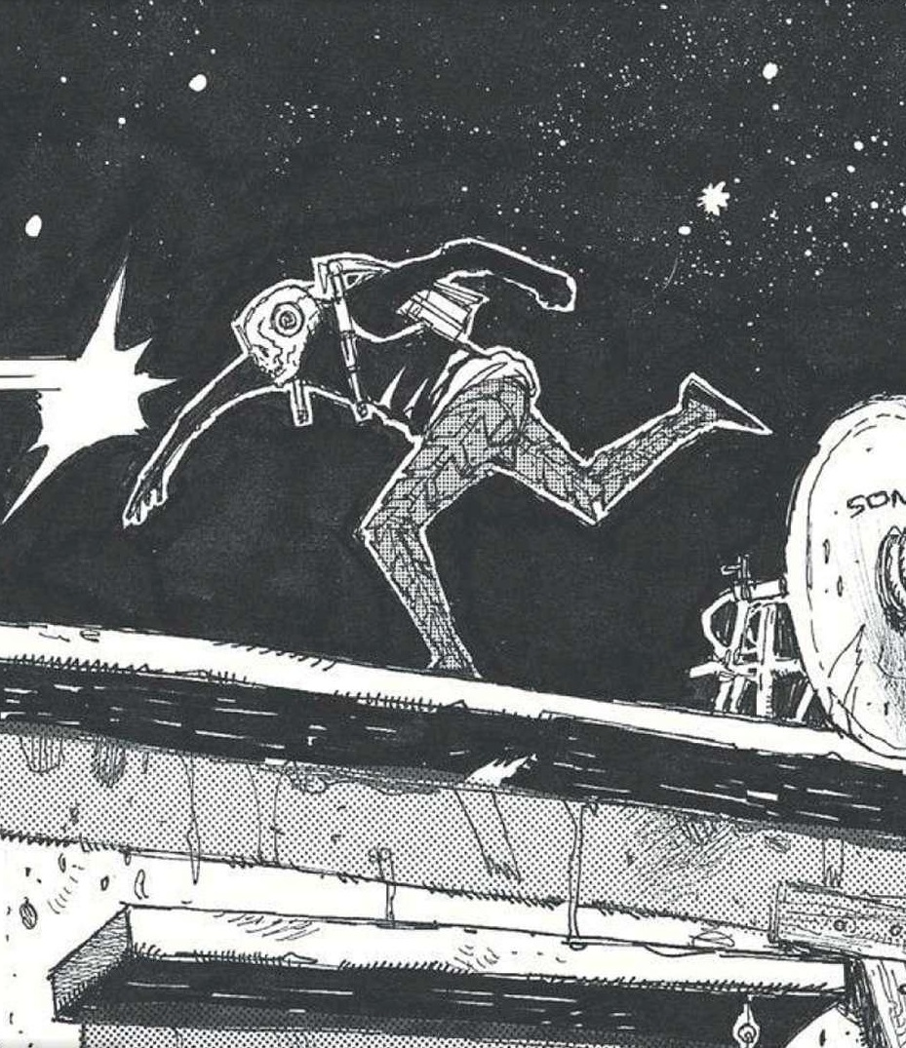
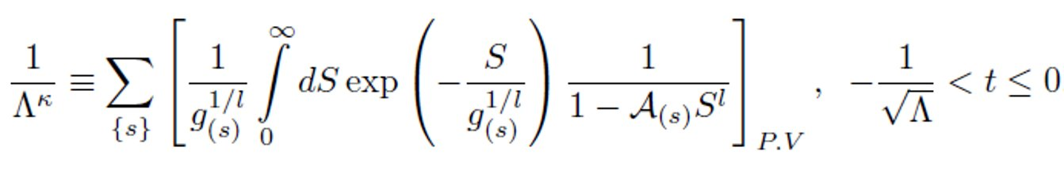
It turns out that the first piece of this expression is exactly the integral form of the cosmological constant:
Being that this quantity is positive definite, we recover the right sign for the cosmological constant, and thus see that we can have de Sitter solutions as coming from type II string compactifications.

